Slide 1
Cultural Considerations
During Children’s Disclosures of Abuse
for
2023 National CAC/CYAC Meeting
March 8 & 9, 2023
​
By : Tara Ettinger, Doctoral work
(Cultural considerations in working with Indigenous children and youth during investigations)
UBC, Okanagan Campus
Funded & Supported by SSHRC

Slide 2
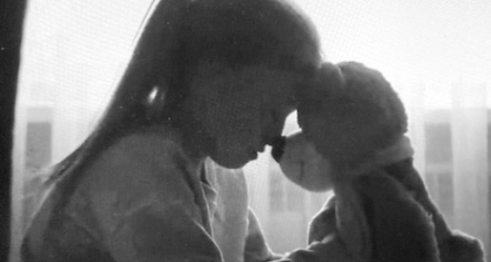
Cultural considerations in working with Indigenous children and youth during investigations of child abuse, particularly during the forensic interview process and within CYACs

Slide 3
I identify myself as a settler ally and respectfully acknowledge the completion of this work on both the unceded territories of the Syilx (Okanagan) Peoples and of the Secwépemc Nation, in which I call home and is where my employment involvement, training, and knowledge has derived from as a trauma therapist in working with children, youth and their families during disclosures of child abuse.
Therefore, I come to this research with the belief…

Slide 4
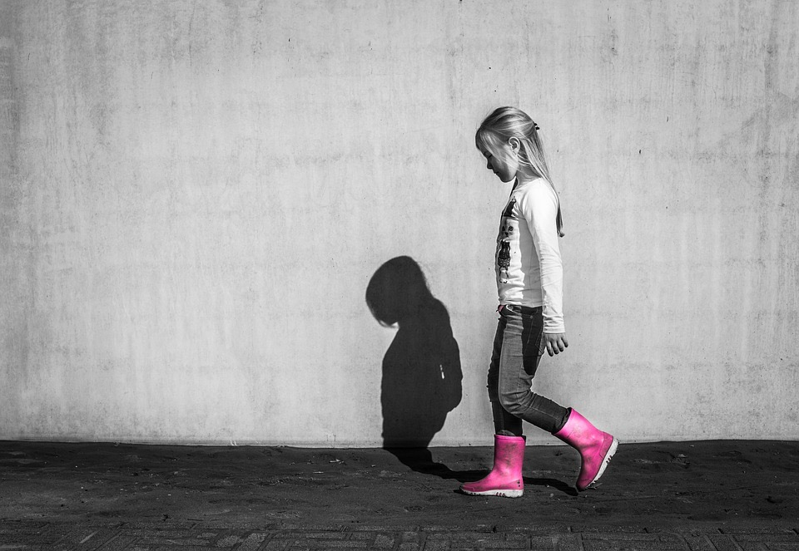
We all need to express our experiences…
if our experiences are sad, scary or harmful…
telling them, is an attempt to release
ourselves from them.
https://www.google.com/search?as_st=y&tbm=isch&as_q=child+shadow+&as_epq=&as_oq=&as_eq=&cr=&as_sitesearch=&safe=images&tbs=sur:fmcsur:fmc

Slide 5
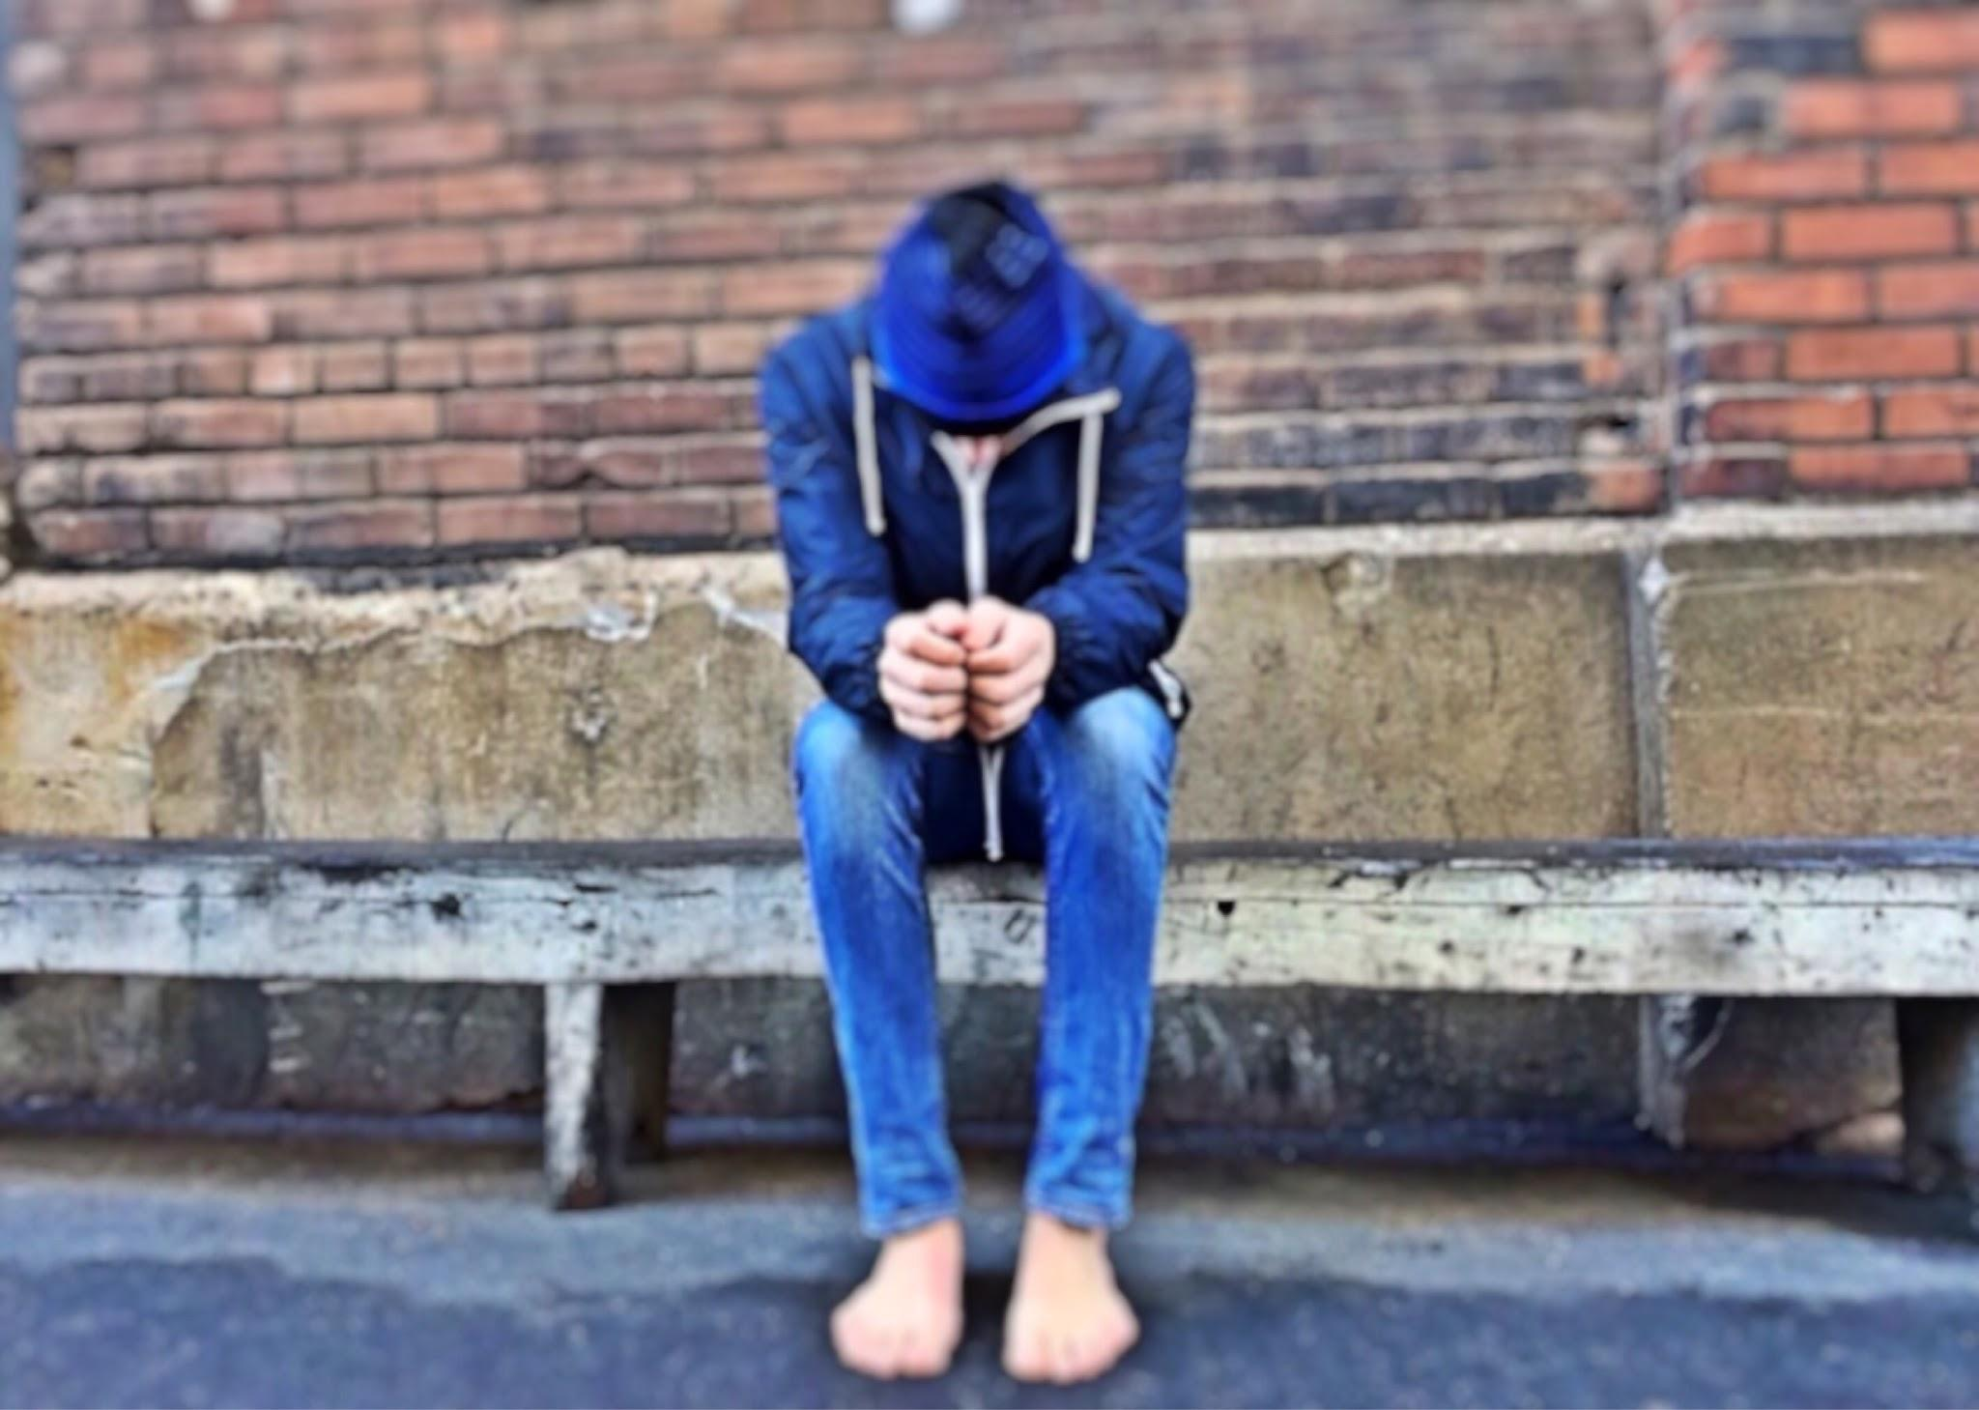
.
Telling about an experience and being heard are essential ingredients in a healing
journey…
A formal disclosure given during a
forensic interview can provide
these opportunities for children
and youth.
https://www.google.com/search?as_st=y&tbm=isch&as_q=youth+street&as_epq=&as_oq=&as_eq=&cr=&as_sitesearch=&safe=images&tbs=sur:fmc

Slide 6
A formal disclosure can indicate strategies regarding the child’s safety and physical/mental health needs
No disclosure may result in more long-term or repeated abuse; identifying a possible offender becomes less likely.

Slide 7
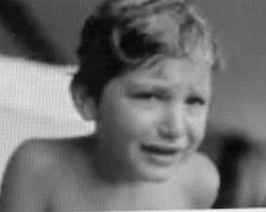
Barriers to disclose

Slide 8
The 30 literature records used for this review
17 empirical, peer-reviewed research studies
2 studies that were identified as grey literature
1 book regarding forensic interviewing of maltreated C & Y
7 reviews
3 government documents.
1758 records
108 - remove duplicates
1650 records removed
41 records after review
67 additional records removed
30 literature records accepted
11 additional records removed

Slide 9
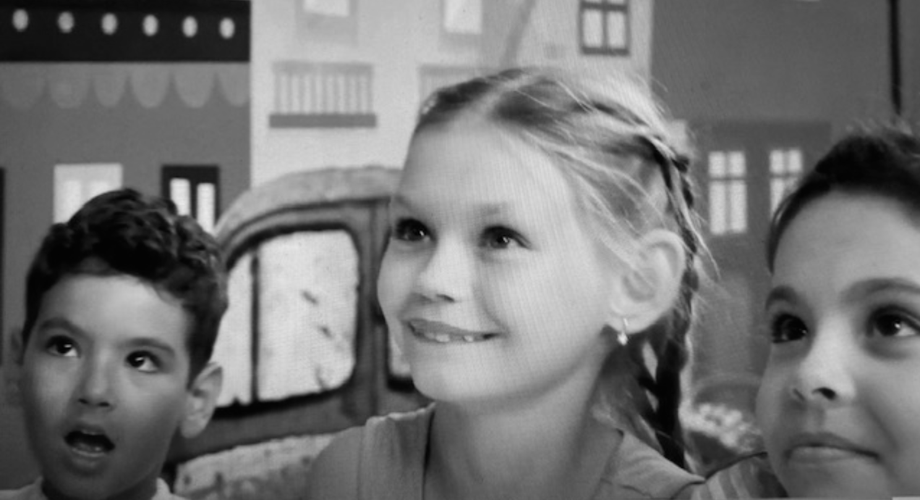
- Half the problems during investigation are due to physical, emotional, cognitive, health, or
behavioural issues presented by the child/youth.
- Many children have been told not to tell (direct threats, bribes, or indirect manipulation).
- May have been told not to trust authority figures.
- Some may simply not want to talk about their abuse with someone who is essentially a
stranger; they may feel embarrassed, ashamed, and/or secretive
(Barter et al., 2001; Newlin et al., 2015; Saywitz & Faller, 2002)

Slide 10
Forensic Interviewer
Child
Many situations for children/youth can create barriers for formal disclosures

Slide 11
Forensic Interviewer
Child
Hard of hearing
Feels
embarrassed

Slide 12
9 Categories
Unique personality/
characteristics
Interviewer relationship needs
Needing Investigation Process Info
Enviro needs
Culture
Mental Health
Family Dynamics
Communication
Physical Abilities

Slide 13
9 Categories with multiple factors in each
LGBTQQIP2SAA ?
How is main caregiver’s level of functioning?
History of violence?
Social issues at school?
Intergenerational trauma?
Are they empowered?
Fears?
Accents/Lang barrier?
Safe?
is child ok in
small rooms?
Unique personality/
characteristics
gender
Is youth preoccupied with possible court outcomes?
Caregiver support?
Understand why here?
Likes/Dislikes?
Uncomfortable with men/women?
Child friendly space?
Teen friendly space?
Interviewer relationship needs
Scared what family will think? Where to live?
Difficulties with trust?
New immigrant?
Needing Investigation Process Info
On medication?
Cultural Differences?
Domestic Violence?
Enviro needs
age
shy?
Cultural Practices/beliefs ?
Need more time rapport building?
Told not to talk?
Level of Trauma?
Cognitive Ability?
Triggers?
Urgent MH concern?
Sign lang?
Chronological Development
deaf/hard of hearing?
Physical limits?
Culture
Talkative?
Mental Health
Family Dynamics
Guilt & Shame
Communication
Physical Abilities
Processing time
Illness?
Family Offender?
Eye contact?
Religion?
believed?

Slide 14
Needless to say…a forensic interview can create some turmoil for children/youth
https://www.google.com/search?as_st=y&tbm=isch&as_q=turmoil&as_epq=&as_oq=&as_eq=&cr=&as_sitesearch=&safe=images&tbs=sur:fmc

Slide 15
Children/youth often become
retraumatized when trying to
retell authorities the horrific
experience
(King & Drost, 2005/2011).

Slide 16
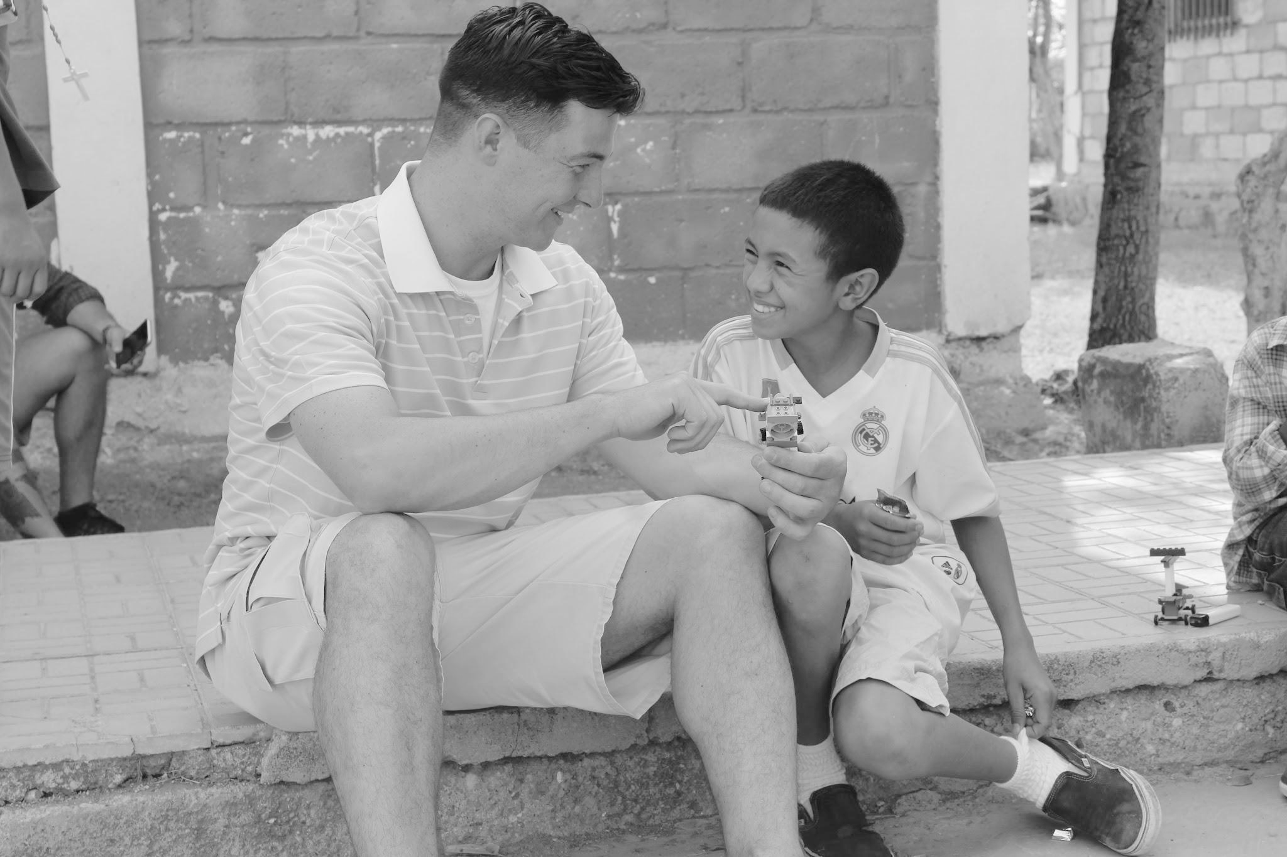
- Interviewing techniques have improved over the years; barriers to disclose now identified more as indicators and opportunities to understand what each specific child needs during disclosures of abuse.
- More recently, some forensic interview protocols have been revised to include more socioemotional support and different rapport-building techniques to reduce children’s anxiety, and to help them overcome some of the obstacles to disclose. (i.e: The National Institute of Child Health and Human Development’s (NICHD) interviewing technique suggests that interviewers use supportive behaviours to better address children’s emotional needs).
(Lamb et al., 2018; Magnusson et al., 2020).
https://www.google.com/search?as_st=y&tbm=isch&as_q=support+child&as_epq=&as_oq=&as_eq=&cr=&as_sitesearch=&safe=images&tbs=sur:fmc

Slide 17
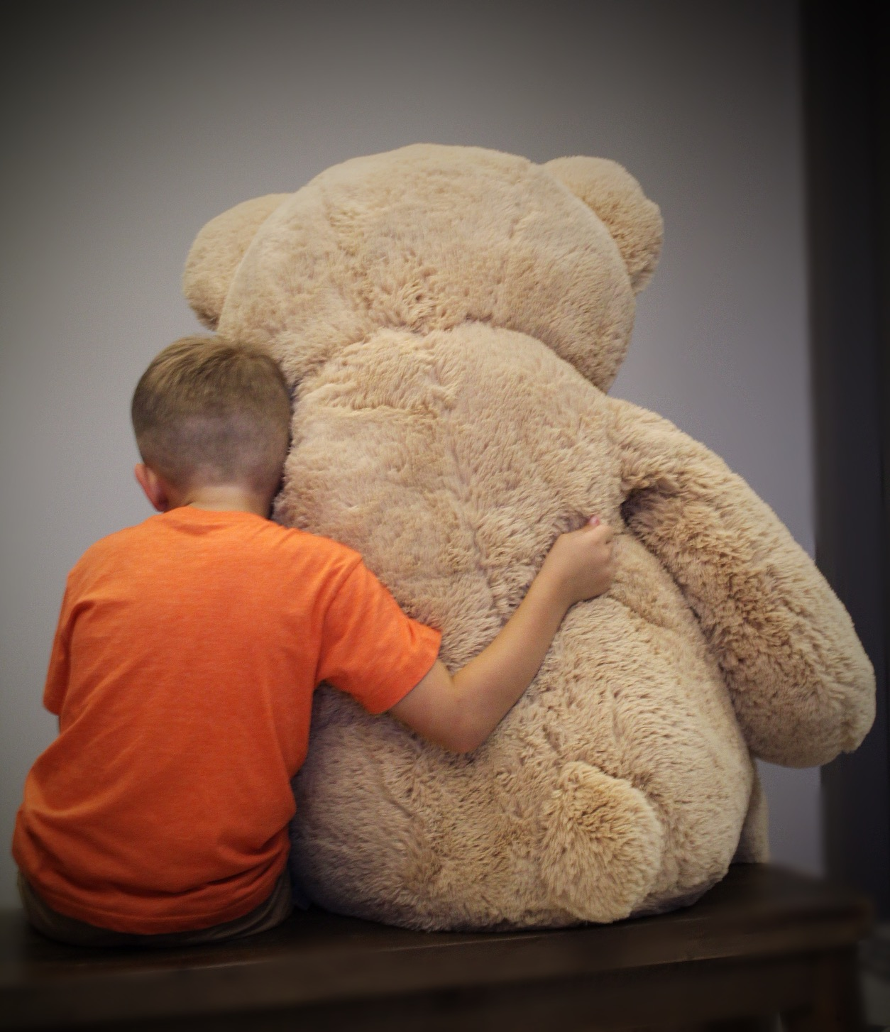
However, there is a need for further research to explore:
. . . ways of adapting child interviewing techniques in a standardized manner
to meet the needs of young children. . . . To facilitate young complainants and
witnesses, all children who are capable of giving testimony should have the
right to be interviewed with techniques suitable for their cognitive development
and socioemotional needs.
(Magnusson et al., 2020, pp. 984–985)

Slide 18
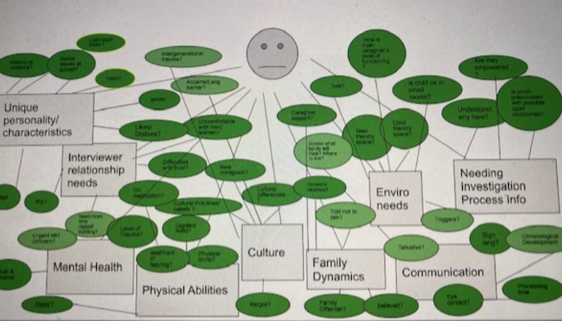
BARRIERS
to
disclose
What does this child
NEED?

Slide 19
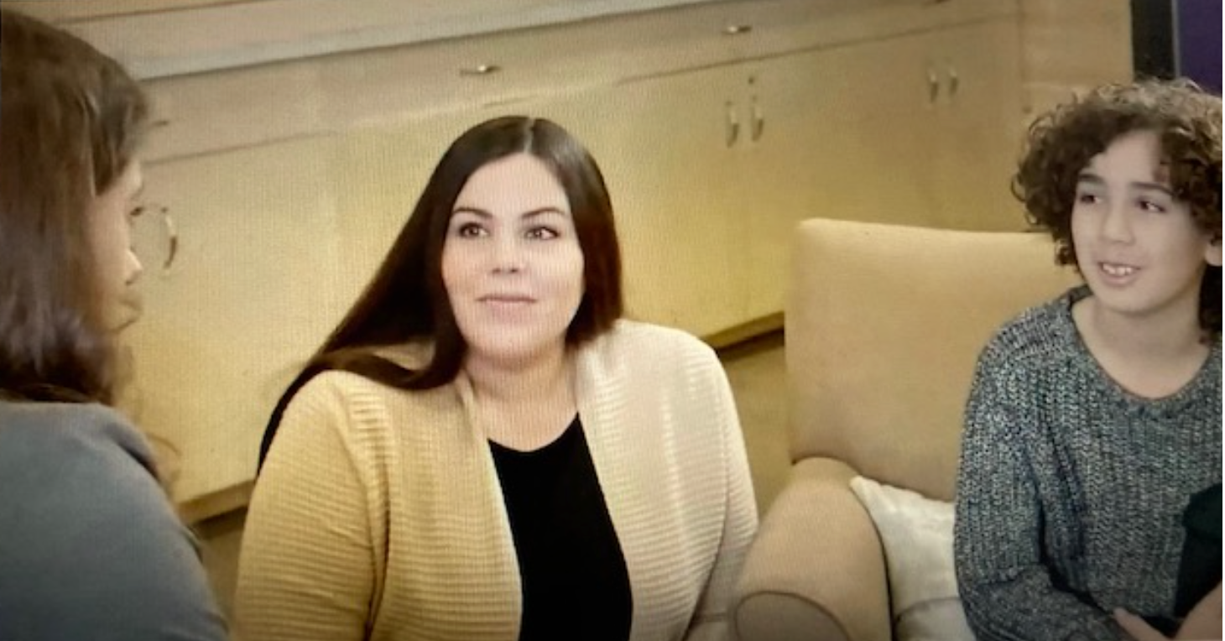
EXAMPLE: Needs within Family Dynamics
- Children with non-offending caregivers who are supportive demonstrate an ability to disclose much more than those that had non-supportive caregivers.
- Therefore, helping caregivers to support their child may help facilitate disclosures.
- Supporting the mother (or other primary caregiver), will also enhance their ability to support their child and increase opportunities for healthier outcomes.
(Middleton, 2017; Paine & Hansen, 2002; Schaeffer et al., 2011; Ungar et al., 2009)

Slide 20
EXAMPLE: Mental Health Needs
During the forensic interview, “if the underlying trauma is not recognized or not responded to appropriately, the chances of retraumatization are increased” (Evans & Graves, 2018, p. 5).
Appropriate forensic interview techniques [are essential]. . . .
The degree of trauma suffered by the child depends to a
greater extent on the way in which the victim will be
treated by . . . the Criminal Justice System following dis-
closure of the incident than on the incident itself. (Themeli & Panagiotaki, 2014, p. 3)

Slide 21
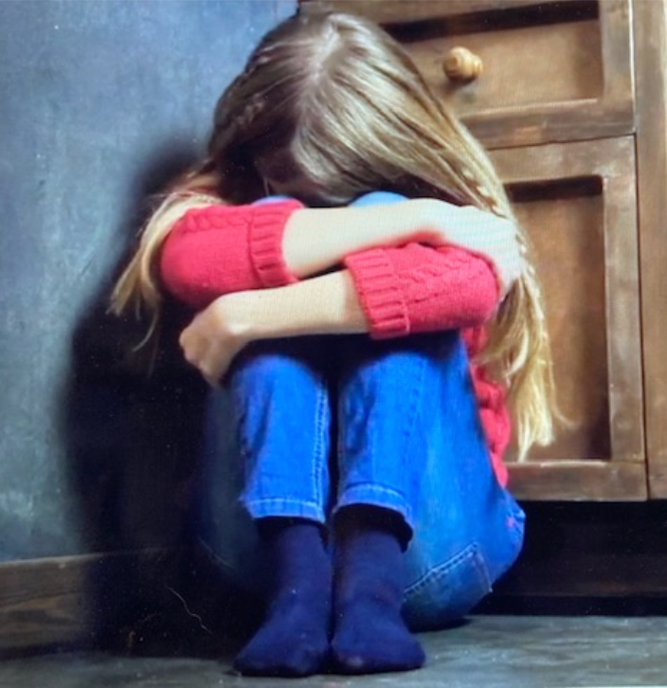
It is crucial for children
& youth to be physically and
and emotionally safe (before, during
and after the interview)
Trauma-Informed Approaches
from CYAC staff, forensic interviewers
and after care connections to services.

Slide 22
- Trauma-informed practice is a person-centred approach - prioritizing children’s needs.
- Such a perspective highlights the need for a methodical forensic interview process
- A well-planned forensic interview that involves learning and knowing the many factors and issues unique to the child, and of any distinct needs that require support. This strategy enhances an interviewer’s awareness of any special accommodations that may be needed to create a safer, more comfortable environment for the child
(Brown et al., 2021; Cederborg et al., 2008; Davies & Westcott, 1999; Milam et al., 2017; Newlin et al., 2015; Rohrabaugh et al., 2016)

Slide 23
Trauma-informed means being reflexive in practice.
A commitment to reflecting on experiences and to considering how the implications of those learnings can impact the broader context in which they work.
This practice also involves professionals’ examining own practices, traumas, triggers, beliefs, assumptions, reasons for their methods and understand how they can impact how we communicate (both verbally and non).
(Goelitz, 2020; Wilson, 2014)

Slide 24
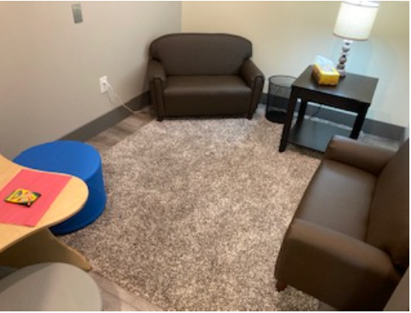
- Trauma-informed is also thinking about the concept of physical ecology : the environment that surrounds a child “includes everything from the availability of green spaces to play in, to the location of child-welfare offices . . . and the physical layout” ( Ungar, 2020, p. 3).
- Thinking about how environments are essentially built based on a set of beliefs about what young people would like or need which is most often “the social and political systems deciding who gets which services delivered in what ways” (Ungar, 2020, p. 3).
- In most cases, concepts evolve from the perspectives of the dominant culture.
- The term best interests of the child - who is asking this question and are we inclusive and reflective when answering it?
- Best interests must include culture.
(Hetherington, 2002; Encyclopedia of Arkansas, 2022; Sinclair, 2016)

Slide 25
LGBTQQIP2SAA ?
How is main caregiver’s level of functioning?
History of violence?
Social issues at school?
Intergenerational trauma?
Are they empowered?
Fears?
Accents/Lang barrier?
Safe?
is child ok in
small rooms?
Unique personality/
characteristics
gender
Is youth preoccupied with possible court outcomes?
Caregiver support?
Understand why here?
Likes/Dislikes?
Uncomfortable with men/women?
Child friendly space?
Teen friendly space?
Interviewer relationship needs
Scared what family will think? Where to live?
Difficulties with trust?
New immigrant?
Needing Investigation Process Info
On medication?
Cultural Differences?
Domestic Violence?
Enviro needs
age
shy?
Cultural Practices/beliefs ?
Need more time rapport building?
Told not to talk?
Level of Trauma?
Cognitive Ability?
Triggers?
Urgent MH concern?
Sign lang?
Chronological Development
deaf/hard of hearing?
Physical limits?
CULTURE
Family Dynamics
Talkative?
Mental Health
Communication
Guilt & Shame
Physical Abilities
Processing time
Illness?
Family Offender?
Eye contact?
Religion?
believed?

Slide 26
“The evidence from history and the study of thousands of diverse cultures around the world are testament to the overwhelming and coercive power of culture to mold who we are and what we believe” (Smedley & Smedley, 2005, p. 17).
“The belief that one can fully understand a culture is naïve, as even one’s own native culture is likely to be diverse and multifaceted” (Barber Rioja & Rosenfeld, 2018, p. 2).

Slide 27
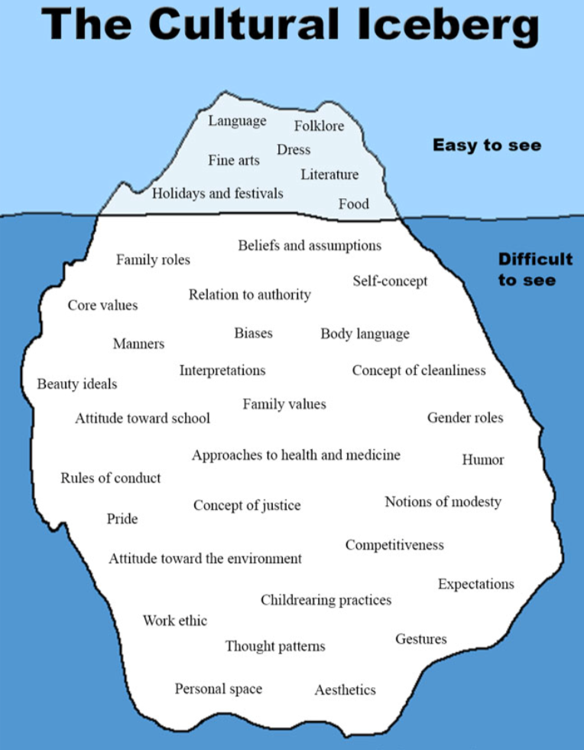
The ‘whole iceberg’ produces the
Individual’s cultural perspective
Earthly Mission Crew, 2022

Slide 28
The Cultural Iceberg of the Child
LGBTQQIP2SAA ?
How is main caregiver’s level of functioning?
History of violence?
Social issues at school?
Intergenerational trauma?
Are they empowered?
Fears?
Accents/Lang barrier?
Safe?
is child ok in
small rooms?
Unique personality/
characteristics
gender
Is youth preoccupied with possible court outcomes?
Caregiver support?
Understand why here?
Likes/Dislikes?
Uncomfortable with men/women?
Child friendly space?
Teen friendly space?
Interviewer relationship needs
Scared what family will think? Where to live?
Difficulties with trust?
New immigrant?
Needing Investigation Process Info
On medication?
Cultural Differences?
Domestic Violence?
Enviro needs
age
shy?
Cultural Practices/beliefs ?
Need more time rapport building?
Told not to talk?
Level of Trauma?
Cognitive Ability?
Triggers?
Urgent MH concern?
Sign lang?
Chronological Development
deaf/hard of hearing?
Physical limits?
CULTURE
Family Dynamics
Talkative?
Mental Health
Communication
Guilt & Shame
Physical Abilities
Processing time
Illness?
Family Offender?
Eye contact?
Religion?
believed?

Slide 29
Culture can be a major influencing factor within children’s disclosures of abuse.
Children grow up learning certain expectations based on cultural messaging that moulds
their communication styles and influences how they feel about disclosing.
“Forensic interviewers and investigators must consider the influence of culture on perception of experiences, memory formation, language, linguistic style, comfort with talking to strangers in a formal setting, and values about family loyalty and privacy when questioning children and evaluating their statements . . . Cultural differences may present communication challenges and can lead to misunderstandings within the forensic interview”. (Newlin et al., 2015, p. 4).
(Alaggia, 2010; Hritz et al., 2015; Newlin et al., 2015).

Slide 30
Cultural differences may create misunderstandings between any professional and a child they are working with.
It is important to have an understanding of the dynamics of cultural differences; to expand cultural knowledge; adapt services to meet culturally unique needs; and to have an ongoing process in learning about cultures, including knowledge of one’s own limitations.
Equally paramount, it is crucial to acknowledge the diversity of culture when providing services for others, particularly in recognizing the influence and power wielded by holding dominant beliefs
(Gilligan & Akhtar, 2005; Malatzky et al., McElvaney, 2008; 2018; Newlin et al., 2015; Woods, 2010)

Slide 31
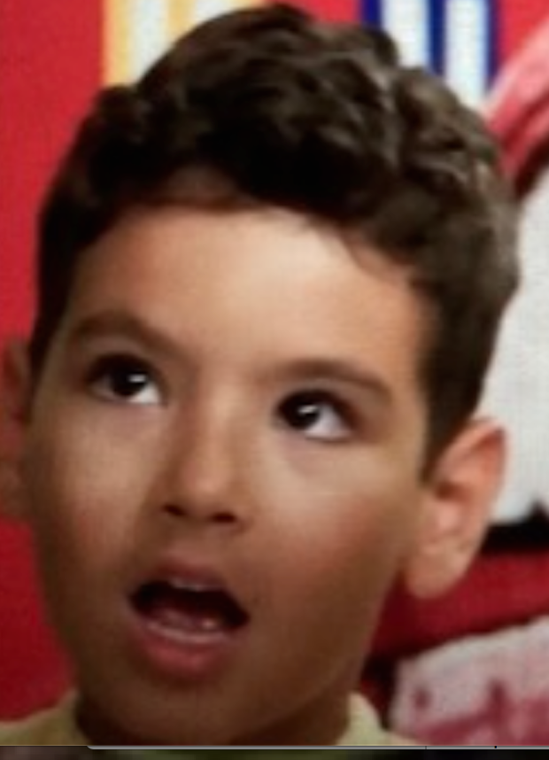
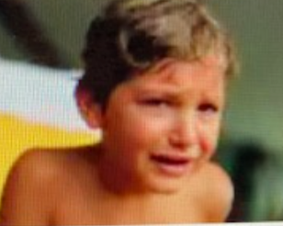
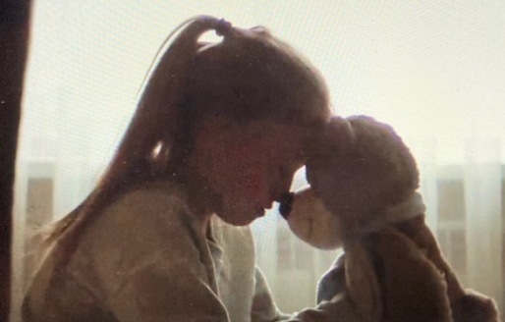
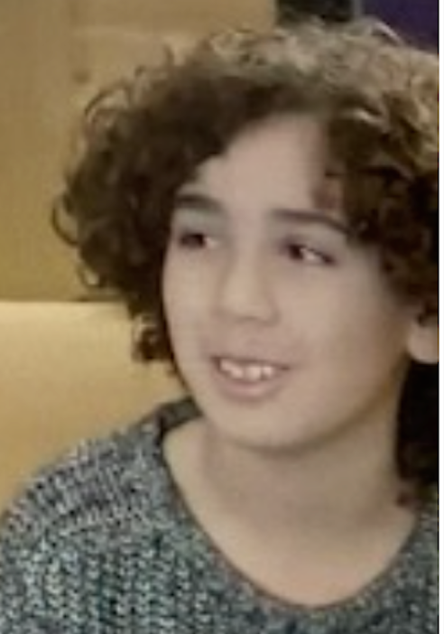
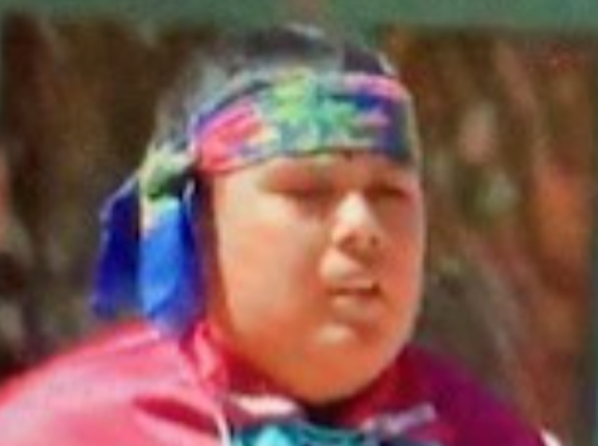
For years, researchers regarding cases of child abuse have questioned how children and their needs can be kept at the forefront of practice? (Fontes & Plummer, 2010; Korbin, 2002; Winkworth & McArthur, 2006)

Slide 32
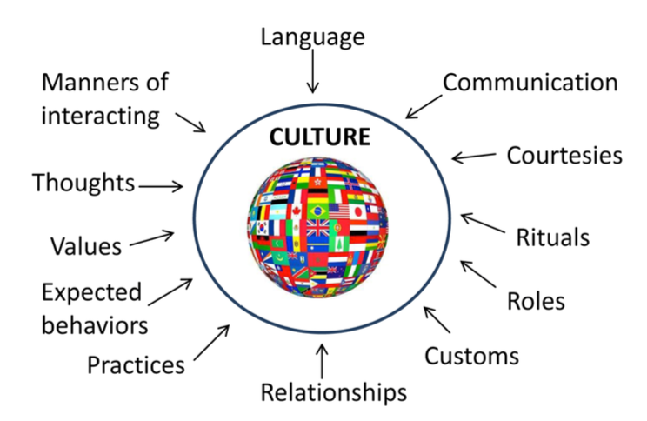
Cultural safety, trauma-informed and inclusivity are inseparable.
What does it mean to incorporate this into all our services & practices during investigations of child abuse?
Image retrieved from: https://www.continued.com/early-childhood-education/ask-the-experts/what-is-culture-23709

Slide 33
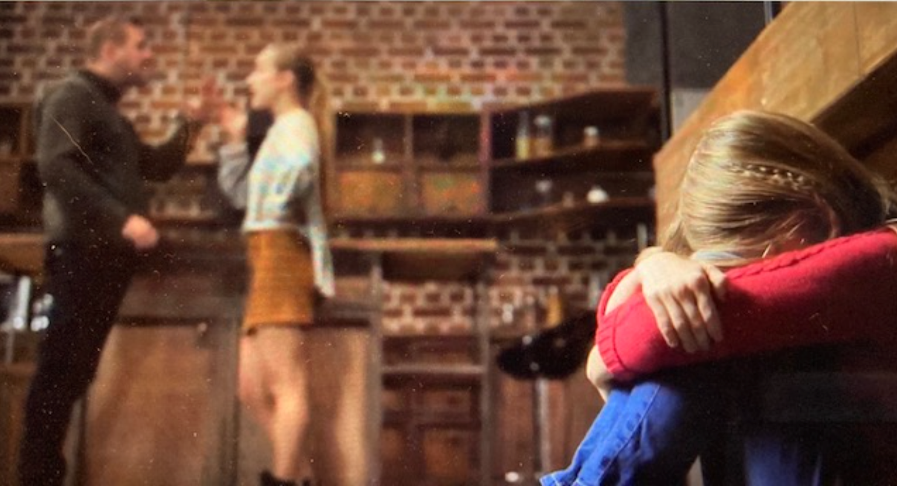
So along with asking “What does this child need”?
We need to recognize that we no nothing about this child & ask ourselves:
“How am I going to learn about this child/youth and their family?”

Slide 34
“ . . sharing of information, including pre- and post-interview debriefings . . . information about the child’s developmental history, cultural background, and special needs (e.g., a known disability) may be useful when planning a forensic interview for the purpose of tailoring interview questions, arranging an interpreter if necessary, and being sensitive to a child’s specific needs or vulnerabilities.” (Rivard & Schreiber Compo, 2017, p. 254)

Slide 35
Being Culturally Aware or Culturally Informed will help us be inclusive in practice.
‘Respectfully Curious’
i.e.: When we know…we will do

Slide 36
“Consultation with professionals who come from the culture in question” (Fontes, 2005, p. 71)

Slide 37
More research and a better understanding for best practices during child-abuse investigations is needed when working with children from various cultures. Specifically, cultural groups with higher prevalence of trauma in our society or those suffering the results of intergenerational trauma; factors that possibly add to the complexities within childhood traumatic experiences, disclosures of abuse, and investigations thereof. This is a difficult and challenging situation, one that may especially be true for Indigenous children & youth.
(Barber Roija & Rosenfeld, 2018; Benuto & Garric, 2016; DeSouza, 2008)

Slide 38
Indigenous population has grown by 42.5 percent over the last decade, which is more than four times the growth rate for non-Indigenous population.
Disproportionate overrepresentation within the welfare system and child maltreatment investigations
40 % of Indigenous Canadians reported having experienced physical or sexual abuse as a child
Children/youth from Indigenous populations around the world have poorer out-comes in the criminal justice system than non-Indigenous children
(Bailey et al., 2017; Blackstock et al., 2004; Bourassa et al., 2015; Indigenous Service Canada, 2018; Sinha et al. et al., 2013)
(Afifi, MacMillan, Boyle, Taillieu, et al., 2014; Statistics Canada, 2016).
https://www.google.com/search?as_st=y&tbm=isch&as_q=Canada+map&as_epq=&as_oq=&as_eq=&cr=&as_sitesearch=&safe=images&tbs=sur:fmc

Slide 39
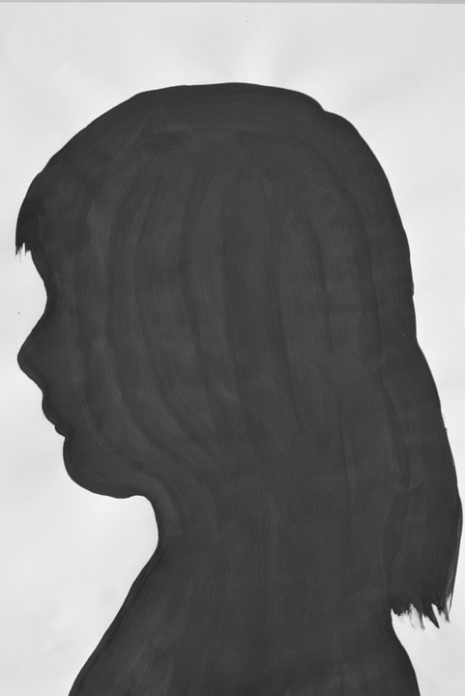
Over the years, Canada has implemented many changes to improve child-welfare approaches. However, more effort is needed to understand appropriate and safe approaches with Indigenous children during investigations of child abuse. Recommendations have been made to gain relevant cultural perspectives, yet studies to better understand culturally safe, trauma-informed, inclusivity with Indigenous communities in investigations of child abuse are almost nonexistent.
(Fontes, 2005; Government of Canada, Department of Justice, 2017; National Collaborating Centre for Aboriginal Health, 2009-2010)
https://www.google.com/search?as_st=y&tbm=isch&as_q=child+shadow+&as_epq=&as_oq=&as_eq=&cr=&as_sitesearch=&safe=images&tbs=sur:fmcsur:fmc

Slide 40
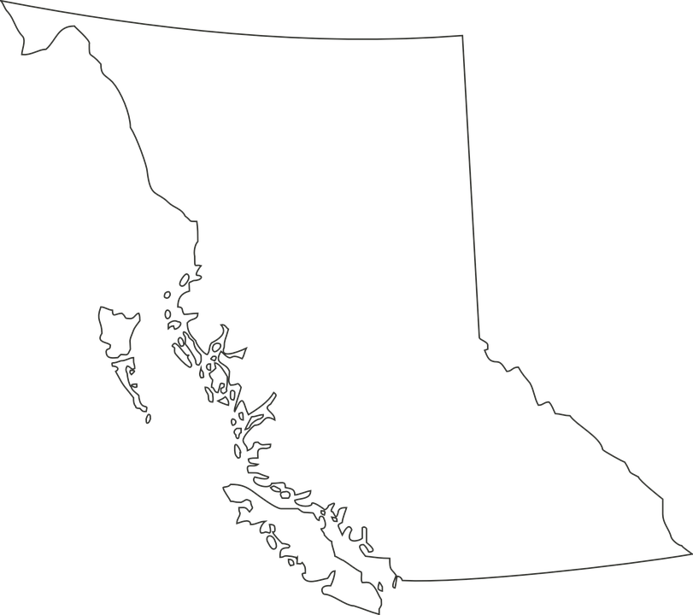
Research: Gaining cultural knowledge from Indigenous professionals involved with Indigenous children/youth during investigations of abuse and disclosures.
A series of guided conversations conducted in British Columbia with Indigenous community members, Elders, and/or professionals.
Themes summarized and expanded upon to enhance practice considerations regarding Indigenous children and youth’s needs during their disclosures of abuse. Specifically Indigenous cultural aspects to consider when Indigenous children and youth are involved in the Canadian criminal justice system, due to suspicions of child abuse. Thus including, when they are involved in child forensic interviews and at Child and Youth Advocacy Centres (CYACs).
https://www.google.com/search?as_st=y&tbm=isch&as_q=british+Columbia+map&as_epq=&as_oq=&as_eq=&cr=&as_sitesearch=&safe=images&tbs=sur:fmc

Slide 41
-Imperative to have a decolonized agenda for moving past colonial lenses.
-Need to demonstrate respect and the value of human beings, ensuring the quality of the person’s experience, and making certain no harm will be created.
-Need to begin with recognizing Indigenous Peoples’ histories, identity, and knowledge systems.
-Understanding how to conduct research with Indigenous participants, especially about such a sensitive topic as child abuse, cannot simply be laid out as a procedure. Instead, created in partnership and as important as the outcomes of this research..
(Coburn, 2013; Datta, 2018; Gillespie et al., 2020; Smith, 2013; Government of Canada, 2018).

Slide 42
- Methodology development: Informal Indigenous Committee
- Research Method: Phenomenological qualitative research design, with a combination of Indigenous methodology using multi community-based and action approaches.
- Recruitment: Word-of-mouth method for recruiting participants (Blended method - i.e: invitations to participate extended by other Indigenous professionals/colleagues. Word-of-mouth method had a snowball effect)

Slide 43
Gathering Data: Guided Conversations vs. interviews
Study involved: several phone calls and face-to-face meetings with 15 participants, beginning in August 2021 to December 2022. (Follow up collaboration January-March 2023).
Findings/Themes: Not to generalize Indigenous perspectives, rather pull common themes together - reflective narratives at the end conversations to capture the main themes from the conversations.
Results: 9 Themes to consider in practice - Disseminated in partnership with Participants (BC CYAC, Big Bear CYAC Steering Advisory Committee)
- Expanded upon through reflection, connection to existing literature, further discussion with Participants and reveal recommendations at micro, meso, and macro sociological viewpoints.

Slide 44
Such as:
MICRO (1-1 level)
Recognizing/helping connect with supportive networks - family/community/Elders (to encourage belonging, connectedness, relationship, healing, safety, and trust within their environment)

Slide 45
SIMILAR to what Slide #19 said regarding: Needs within Family Dynamics
- Children with non-offending caregivers who are supportive demonstrate an ability to disclose much more than those that had non-supportive caregivers.
- Therefore, helping caregivers to support their child may help facilitate disclosures.
- Supporting the mother (or other primary caregiver), will also enhance their ability to support their child and increase opportunities for healthier outcomes.
* Indigenous communities are collectivist cultures
* Family cannot be defined from a Westernized lens
(Middleton, 2017; Paine & Hansen, 2002; Schaeffer et al., 2011; Ungar et al., 2009)

Slide 46
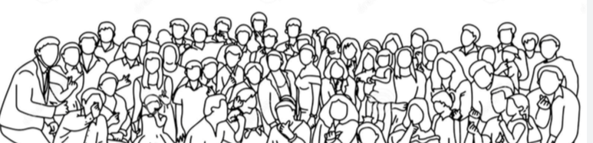
MESO (Agency level)
Develop partnerships, practice agreements, evaluation outcomes etc. with local Indigenous communities/agencies
Be committed to learning (every Indigenous community will have its own norms)
“Do you want answers, or do you want to understand?”

Slide 47
Best Practices for Indigenous Engagement
Identify
Learn/Research
Plan
Engage
Maintain
GAMBLE & McQUEEN, 2019; Indigenous Corporate Training, 2022

Slide 48
MACRO (Community/Government)
Hold meso groups, communities, or organizations accountable in acknowledging/addressing micro and meso level needs (i.e: demonstrate partnerships with local Indigenous communities in funding applications…letters of support, MOUs)

Slide 49
- Trauma-informed approaches need to be implemented into all services and across all populations
- The focus is on recognizing and prioritizing the “emotional vulnerability of trauma survivors, and most important, the worker avoids inadvertently repeating dynamics of abusive interactions in the helping relationship” (Levenson & Levenson, 2017, p. 106).

Slide 50
- Study of adult children of Holocaust survivors. Their parents, numb or desensitized from extremely painful and horrific experiences, may not have been able to provide the emotional connectivity the children needed (Yehudaet al.,2001).
-Trauma has shaped Indigenous communities and the lack of healing for one generation can create problems for the next, having an effect on every Indigenous person (Brokenleg, 2012)
-As a result, many individuals continue to experience adversities. Suicide, depression, and addiction are only some of the consequences attributed to the intergenerational trauma that Indigenous people experience to this day (Hackett et al., 2016).

Slide 51
- Intense experiences send neurobiological, neurone-doctrine, and neuropsychological responses to the brain, possibly initiating fight-or-flight survival strategies (Perry, 2003). Biologically proven that mothers who have suffered childhood trauma can pass this memory down to utero.
Continually being in the presence of repeated adversities during childhood can lead to a child to internalize those events, contributing to the continuation of this intergenerational cycle (Bombay et al., 2009).
The effects of intergenerational trauma can have deep impacts on many aspects of a child’s life, from how they view themselves to how they communicate with others (PsychCentral, 2022).

Slide 52
Trauma-informed approaches appear to be key in being able to create inclusive and culturally safe work. In order to practice trauma-informed, one must have an understanding for the cultural needs.
“It can be harmful to ignore culture” (Goelitz, 2021, p. 22)

Slide 53
- Working in partnership and being respectfully curious can help one understand another’s culture and to find ways to incorporate cultural aspects into services - this is inclusivity in practice.
- Asking questions to explore and gain knowledge about who a person is, while “appreciating the attributes found there” (Goelitz, 2021, p. 22) are elements in being trauma-informed.

Slide 54
- Being trauma-informed can strengthen the professional-client relationship and encourage post-traumatic healing because the principles of this practice are to create a safe environment for clients that prioritize the need for safety, trust, collaboration, choice, and empowerment at the forefront of service delivery (Levenson & Levenson, 2017).
- Interestingly, these are the same principles all the Indigenous participants indicated as what Indigenous children and youth need within services and during their disclosures of abuse, specifically in the forensic interviews and CYAC settings.

Slide 55
- Also interesting, Indigenous scholars and communities have been demonstrating and requesting these needs in service delivery with Indigenous people for years.
-Improvements in practice are slowly occurring. However, the term it takes a whole village to raise a child, relates to the message this research indicates regarding the need for a commitment in working together and providing Indigenous children and youth the service delivery they need.
-These ethical and reconciliation efforts are only as good as the commitment in deciding to follow through on them, and all people who reside in Canada have an obligation to do their part.
(traditionally an African proverb, now adopted by many North Ameri- can Indigenous communities, Pence, 1999)

Slide 56
Thank you!

Slide 57
References
Alaggia, R. (2010, February). An ecological analysis of child sexual abuse disclosure: Considerations for child and adolescent mental health. Journal of the Canadian Academy of Child and Adolescent Psychiatry/Journal de l'Académie canadienne de psychiatrie de l'enfant et de l'adolescent, 19(1), 32–39.
Bailey, C., Powell, M., & Brubacher, S. P. (2017). The attrition of indigenous and non-indigenous child sexual abuse cases in two Australian jurisdictions. Psychology, Public Policy, and Law, 23(2), 178.
Barber Rioja, V., & Rosenfeld, B. (2018). Addressing linguistic and cultural differences in the forensic interview. International Journal of Forensic Mental Health, 17(4), 377-386.
Benuto, L. T., & Garrick, J. (2016). Cultural considerations in forensic interviewing of children. In Forensic interviews regarding child sexual abuse (pp. 351-364). Springer, Cham.
Blackstock, C., Trocmé, N., & Bennett, M. (2004). Child maltreatment investigations among Aboriginal and non-Aboriginal families in Canada. Violence against women, 10(8), 901–916.
Bombay, A., Matheson, K., & Anisman, H. (2009). Intergenerational trauma: Convergence of multiple processes among First Nations peoples in Canada. International Journal of Indigenous Health, 5(3), 6-47.
Brokenleg, M. (2012). Transforming cultural trauma into resilience. Reclaiming children and youth, 21(3), 9.
Brown, D., Walker, D., & Godden, E. (2021). Tele-forensic interviewing to elicit children’s evidence—Benefits, risks, and practical considerations. Psychology, Public Policy, and Law, 27(1), 17.
Davies, G. M., & Westcott, H. L. (1999). Interviewing child witnesses under the Memorandum of Good Practice: A research review (Police Research Series, Paper 115). Retrieved from http://lx.iriss.org.uk/sites/default/files/resources/040.%20Research%20Review%20of%20the%20Memorandum%20of%20Good%20Practice.pdf
DeSouza, R. (2008). Wellness for all: the possibilities of cultural safety and cultural competence in New Zealand. Journal of Research in Nursing, 13(2), 125–135.
Encyclopedia of Arkansas. (2020). James Albert Banks (1941-). Retrieved from https://encyclopediaofarkansas.net/entries/james-albert-banks-4682/
Fontes, L. A. (2005). Child abuse and culture: Working with diverse families. New York, NY: The Guilford Press.

Slide 58
Fontes, L. A., & Plummer, C. (2010). Cultural issues in disclosures of child sexual abuse. Journal of Child Sexual Abuse, 19(5), 491–518.
Indigenous Corportate Training Inc. (2022a). Working effectively with indigenous peoples. Retrieved from https://www.ictinc.ca/blog/first-nation-talking-stick-protocol
Indigenous Services Canada. (2018). Government of Canada, with First Nations, Inuit and Métis Nation leaders, announce co-developed legislation will be introduced on Indigenous child and family services in early 2019 [News release]. Retreived from https://www.canada.ca/en/indigenous-services-canada/news/2018/11/government-of-canada-with-first-nations-inuit-and-metis-nation-leaders-announce-co-developed-legislation-will-be-introduced-on-indigenous-child-and.html
Korbin, J. E. (2002). Culture and child maltreatment: Cultural competence and beyond. Child Abuse & Neglect, 26(6–7), 637–644.
Levenson, J., & Levenson, J. (2017). Social Work (New York): Trauma-informed social work practice. National Association of Social Workers. doi:10.1093
Goelitz,A. (2020). From Trauma to Healing: A Social Worker’s Guide to Working with Survivors. 2nd Edi- tion. New York, Routledge.
Government of Canada. (2017). Draft national guidelines for child advocacy centres/child and youth advocacy centres in Canada.
Government of Canada. (2018). Government of Canada, with First Nations, Inuit and Métis Nation leaders, announce co-developed legislation will be introduced on Indigenous child and family services in early 2019. Retrieved from https://www.canada.ca/en/indigenous-services-canada/news/2018/11/government-of-canada-with-first-nations-inuit-and-metis-nation-leaders-announce-co-developed-legislation-will-be-introduced-on-indigenous-child-and.html
Google Advanced Images Search (2018). Usage rights: free to use, share or modify, even commercially. Retrieved from:
https://www.google.com/search?as_st=y&tbm=isch&as_q=boy+girl+image&as_epq=&as_oq=&as_eq=&cr=&as_sitesearch=&safe=images&tbs=sur:fmc

Slide 59
https://www.google.com/search?as_st=y&tbm=isch&as_q=british+columbi+map&as_epq=&as_oq=&as_eq=&cr=&as_sitesearch=&safe=images&tbs=sur:fmc
https://www.google.com/search?as_st=y&tbm=isch&as_q=canada+map&as_epq=&as_oq=&as_eq=&cr=&as_sitesearch=&safe=images&tbs=sur:fmc
https://www.google.com/search?as_st=y&tbm=isch&as_q=support+child&as_epq=&as_oq=&as_eq=&cr=&as_sitesearch=&safe=images&tbs=sur:fmc
Image retrieved from: https://www.continued.com/early-childhood-education/ask-the-experts/what-is-culture-23709
https://www.google.com/search?as_st=y&tbm=isch&as_q=culture&as_epq=&as_oq=&as_eq=&cr=&as_sitesearch=&safe=images&tbs=sur:fmc
https://www.google.com/search?as_st=y&tbm=isch&as_q=holding+hands&as_epq=&as_oq=&as_eq=&cr=&as_sitesearch=&safe=images&tbs=sur:fmc
https://www.google.com/search?as_st=y&tbm=isch&as_q=police+officer&as_epq=&as_oq=&as_eq=&cr=&as_sitesearch=&safe=images&tbs=sur:fmc
https://www.google.com/search?as_st=y&tbm=isch&as_q=rcmp&as_epq=&as_oq=&as_eq=&cr=&as_sitesearch=&safe=images&tbs=sur:fmc
https://www.google.com/search?as_st=y&tbm=isch&as_q=child+shadow+&as_epq=&as_oq=&as_eq=&cr=&as_sitesearch=&safe=images&tbs=sur:fmcsur:fmc
https://www.google.com/search?as_st=y&tbm=isch&as_q=support+child&as_epq=&as_oq=&as_eq=&cr=&as_sitesearch=&safe=images&tbs=sur:fmc
https://www.google.com/search?as_st=y&tbm=isch&as_q=turmoil&as_epq=&as_oq=&as_eq=&cr=&as_sitesearch=&safe=images&tbs=sur:fmc
https://www.google.com/search?as_st=y&tbm=isch&as_q=youth+street&as_epq=&as_oq=&as_eq=&cr=&as_sitesearch=&safe=images&tbs=sur:fmc
Magnusson, M., Ernberg, E., Landström, S., & Akehurst, L. (2020). Forensic interviewers’ experiences of interviewing children of different ages. Psychology, Crime & Law, 26(10), 967-989.
Malatzky, C., Nixon, R., Mitchell, O., & Bourke, L. (2018). Prioritising the cultural inclusivity of a rural mainstream health service for first nations australians: An analysis of discourse and power. Health Sociology Review, 27(3), 248–262. doi:10.1080/14461242.2018.1474720
Middleton J. (2017). Memory development and trauma in preschool children: Implications for forensic interviewing professionals - A Review of the Literature. Forensic Res Criminol Int J.;4(1):21-25. DOI: 10.15406/frcij.2017.04.00100

Slide 60
Milam, M., Borrello, N., & Pooler, J. (2017). The survivor-centered, trauma-informed approach. US Att'ys Bull., 65, 39.
McElvaney, R. (2008). How children tell: Containing the secret of child sexual abuse (Unpublished doctoral disser- tation). Trinity College, Dublin. Retrieved from http://www.tara.tcd.ie/bitstream/handle/2262/77577/McElvaney%2C%20Rosaleen_thesis.pdf?sequence=1&isAllowed=y
Paine, M. L., & Hansen, D. J. (2002). Factors influencing children to self-disclose sexual abuse. Clinical Psychology Review, 22(2), 271–295. doi:10.1016/S0272-7358(01)00091-5
Perry, B. D. (2003). Effects of traumatic events on children. The child trauma academy, 1-21.
PsychCentral. (2022). How to break the cycle of intergenerational trauma. Retrieved from https://psychcentral.com/ptsd/stopping-the-cycle-of-trauma-parents-need-help-for-trauma-too#trauma-cycle-causes
Gilligan, P., & Akhtar, S. (2005, October). Cultural barriers to the disclosure of child sexual abuse in Asian commu- nities: Listening to what women say. The British Journal of Social Work, 36(8), 1361–1377. doi:10.1093/ bjsw/bch309
Hetherington, R. (2002, June). Learning from difference: Comparing child welfare systems. Keynote address at the Positive systems of Child Welfare Conference, Waterloo, ON. Retrieved from https://scholars.wlu.ca/pcfp/12/
Hritz, A. C., Royer, C. E., Helm, R. K., Burd, K. A., Ojeda, K., Ceci, S. J. (2015). Children's suggestibility research: Things to know before interviewing a child. Anuario de Psicología Jurídica, 25, 3–12. Retrieved from http://www.sciencedirect.com/science/article/pii/S1133074015000124
King, D. N., & Drost, M. (2011). Recantation and false allegations of child abuse: Selected bibliography (Updated ed., M. K. Wells, Ed.). Huntsville, AL: National
Children’s Advocacy Center. Retrieved from https://www.icmec.org/wp-content/uploads/2015/10/ Recantations-and-False-Allegations-Bibliography.pdf
(Original work published 2005)

Slide 61
References Con’t
Newlin, C., Cordisco Steele, L., Chamberlin, A., Anderson, J., Kenniston, J., Russell, A., . . . Vaughan-Eden, V. (2015). Child forensic interviewing: Best practices. Retrieved from https://www.ojjdp.gov/pubs/248749.pdf
Rohrabaugh, M., London, K., & Hall, A. K. (2016). Planning the forensic interview. In Forensic Interviews Regarding Child Sexual Abuse (pp. 197-218). Springer, Cham.
Sinclair, R. (2016). The Indigenous child removal system in Canada: An examination of legal decision-making and racial bias. First Peoples Child & Family Review: An Interdisciplinary Journal Honouring the Voices, Perspectives, and Knowledges of First Peoples through Research, Critical Analyses, Stories, Standpoints and Media Reviews, 11(2), 8-18.
Schaeffer, P., Leventhal, J. M., & Asnes, A. G. (2011). Children’s disclosures of sexual abuse: Learning from direct inquiry. Child Abuse & Neglect, 35, 343–352.
Smedley, A., & Smedley, B. D. (2005). Race as biology is fiction, racism as a social problem is real: Anthropological and historical perspectives on the social construction of race. American Psychologist, 60(1), 16.
Sinha, V., Trocmé, N., Fallon, B., & MacLaurin, B. (2013, October). Understanding the investigation- stage overrepresentation of First Nations children in the child welfare system: An analysis of the First Nations component of the Canadian incidence study of reported child abuse and neglect 2008. Child Abuse & Neglect, 37(10), 821–831. doi:10.1016/j.chiabu.2012.11.010
Statistics Canada. (2016). Aboriginal Peoples in Canada: First Nations people, Métis and Inuit. Retrieved from
http://www12.statcan.gc.ca/nhs-enm/2011/as-sa/99-011-x/99-011-x2011001-eng.cfm
Townsend, C. (2016). Child sexual abuse disclosure: What practitioners need to know. Retrieved from
http://www.d2l.org/atf/cf/%7B64AF78C4-5EB8-45AA-BC28- F7EE2B581919%7D/ChildSexualAbuseDisclosurePaper_20160217_v.1.pdf
Ungar, M., Tutty, L. M., McConnell, S., Barter, K., & Fairholm, J. (2009). What Canadian youth tell us about disclosing abuse. Child Abuse & Neglect, 33(10), 699–708. doi:10.1016/j.chiabu.2009.05.002
Themeli, O., & Panagiotaki, M. (2014). Forensic interviews with children victims of sexual abuse: the role of the counselling psychologist.
Wilson, A. (2014). Addressing uncomfortable issues: Reflexivity as a tool for culturally safe practice in Aboriginal and Torres Strait Islander health. The Australian Journal of Indigenous Education, 43(2), 218–230.
Winkworth, G., & McArthur, M. (2006). Being “child centred” in child protection: What does it mean? Children Australia, 31(4), 13–21.

