Slide 1
CYAC
Mindfulness +
Work Life Balance

Slide 2
Structure
Mini Meditation - Breathwork
Mindfulness In Your Daily Life
Mindful Moment - Body Scan
Mindful Boundaries - Work/Home
Q&A

Slide 3
Samantha Clarke
she/her/hers

Slide 4
Mini Meditation
Calming Breath

Slide 6
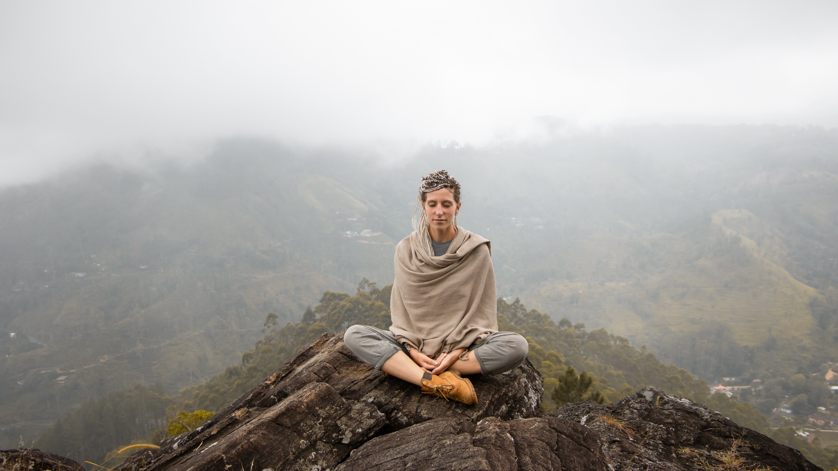

Slide 8
Mindfulness
Awareness of the Present Moment
On Purpose
Without Judgement
Vast applications.
Meditation
One Way to Practice
Often Seated
Concentrated Focus

Slide 12
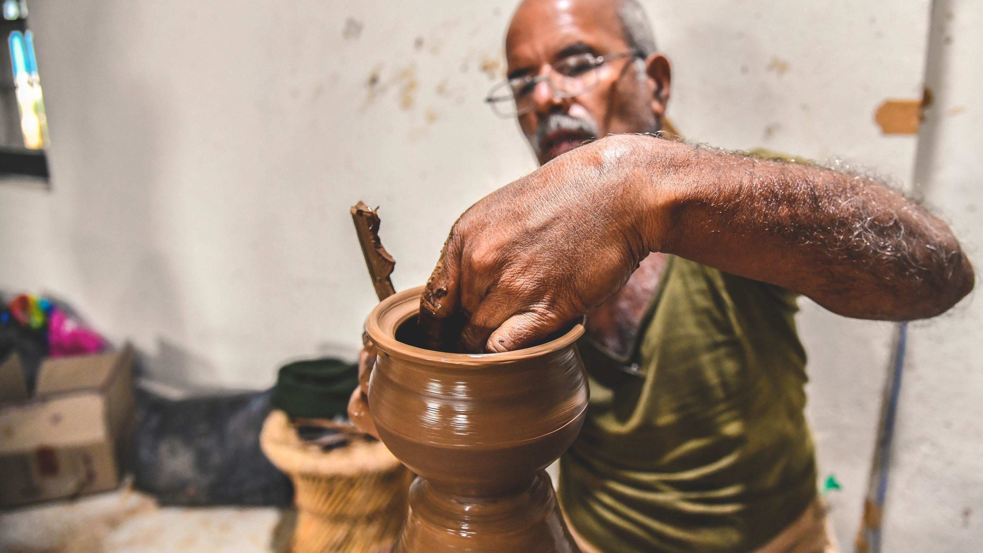

Slide 15
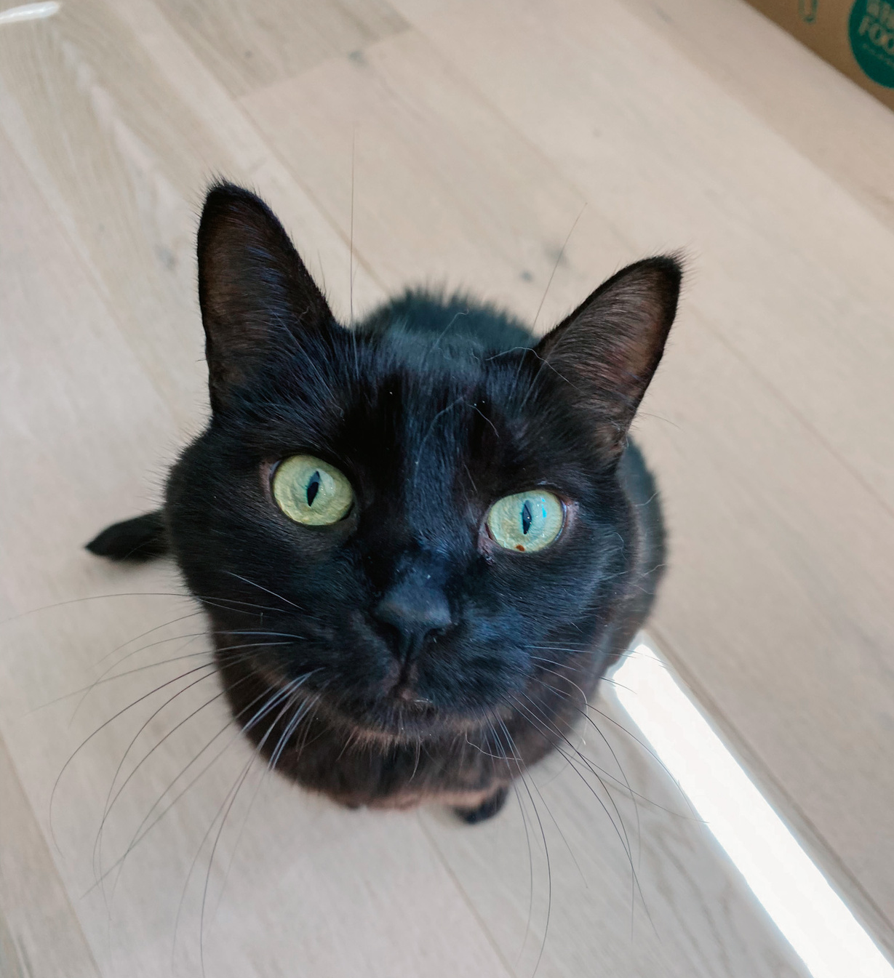

Slide 17
Share
How do you know when you're stressed?

Slide 20
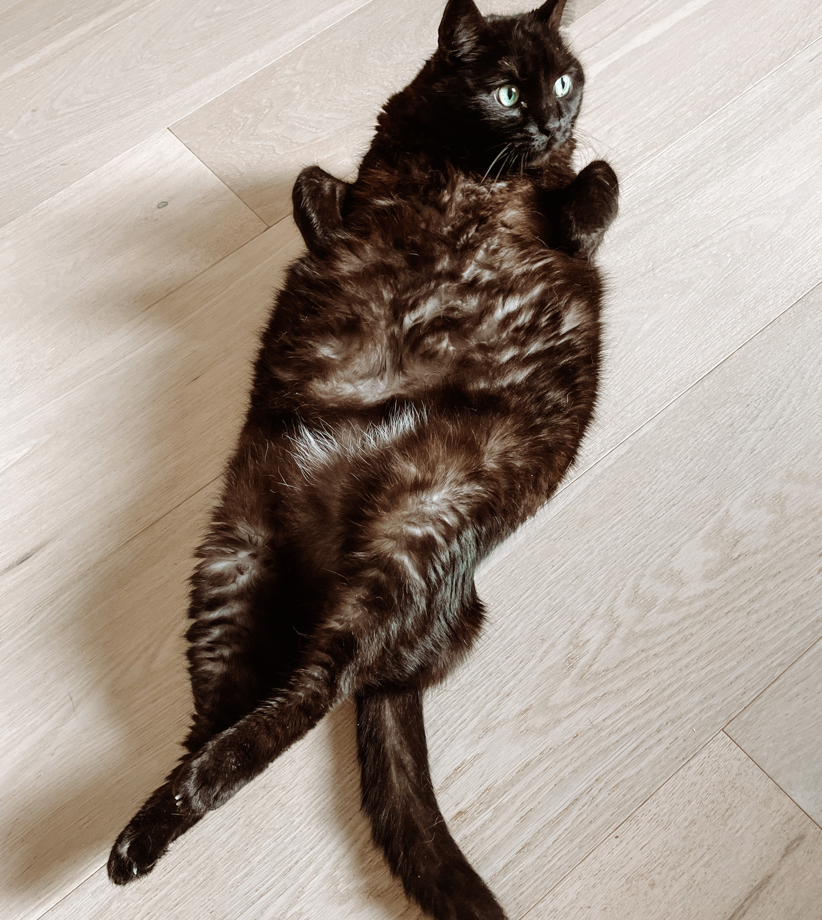

Slide 22
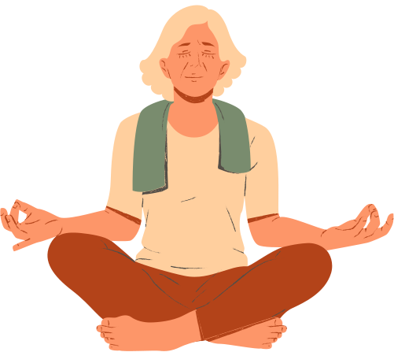
"You should meditate for 10 minutes a day.
Unless you're too busy, then you should meditate for an hour."

Slide 23
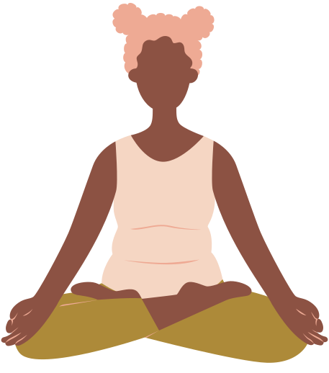
Take a 2 minute screen break
Take 2 deep breaths before a meeting
Eat without technology

Slide 24
Mindful Moment Challenge
Bathroom
break
1. Something you do daily
Brushing teeth
Having dinner
2 Usually done mindlessly
3. Uses felt sense
Walking the dog
Showering

Slide 25
Mindful Moment Challenge
Brushing teeth
Acknowledge the task
Notice the felt sense
Notice your mind wandering
Guide your attention back

Slide 26
Share
Where Will You Have Your Mindful Moment?

Slide 27
Mindful Moment
Body Scan

Slide 28
Mindful Boundaries for Work and Life

Slide 29
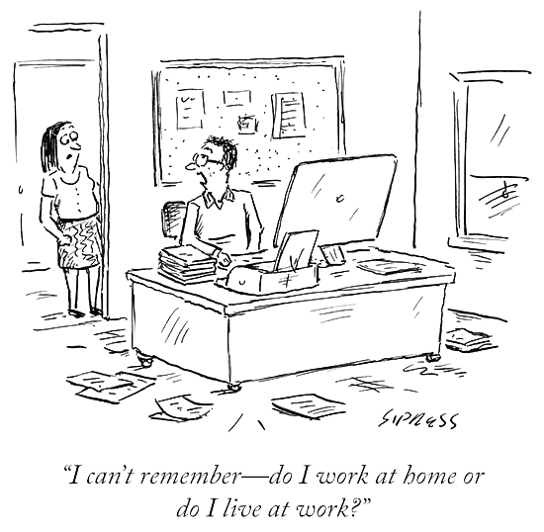

Slide 31
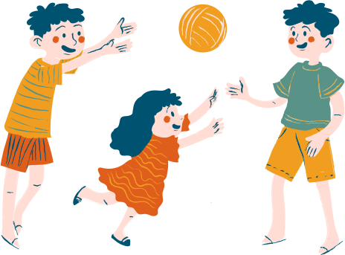
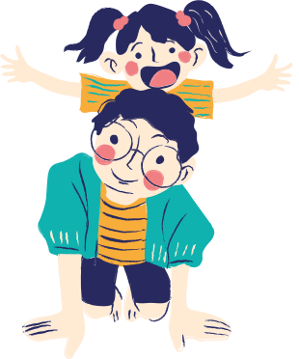
"LIMBO TIME"

Slide 32
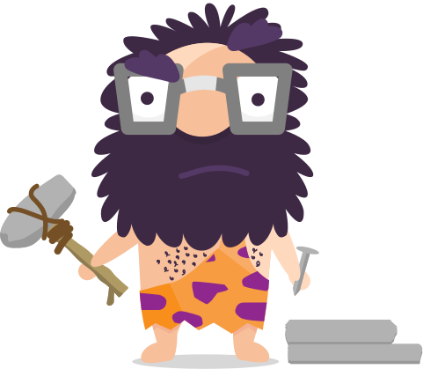
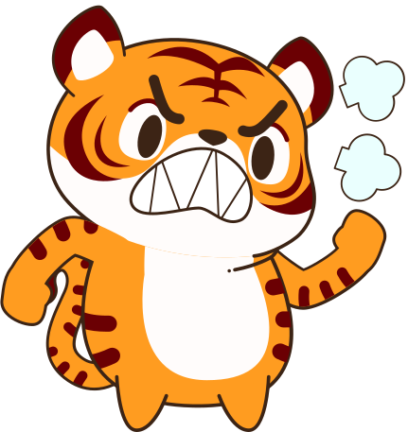
Prolonged Stress
Mental
Poor decision making
Irritability
Decision Fatigue
Anxiety
Depression
Trouble concentrating
Constant worrying
Neglecting responsibilities
Physical
Headaches
Poor Digestion
Loss of Libido
Trouble sleeping
Substance use/abuse
Inflammation
Bruxism
High blood pressure

Slide 33
Creating Boundaries
Physical Boundaries
Mental Boundaries

Slide 34
Creating Boundaries
Physical Boundaries
Mental Boundaries
Phone in another room
Emails from the office
Exercise before or after work
Close office door

Slide 35
Creating Boundaries
Physical Boundaries
Mental Boundaries
Phone in another room
Emails from the office
Exercise before or after work
Close office door
Meditation
Mindful walk
Journalling
Listen to music
Change clothes

Slide 36
"Almost everything will work again if you unplug it for a few minutes, including you."
Annie Lamott

Slide 37
Take Aways
Mindfulness only takes a moment
Mindfulness is like a muscle - it's strengthens through repetition.
The more you give to yourself, the more you have to give

Slide 38
"If you change the way you you look at things, the things you look at change"
DR. Wayne Dyer.

Slide 39
Thank You!
samanthashakiraclarke.com
team@samanthashakiraclarke.com

